Slide 1


Quality of service analysis
Electric Power Load Analysis (EPLA)
Revision of 8 August 2026
Dr. Norbert Doerry
http://doerry.org/norbert/MarineElectricalPowerSystems/index.htm
© 2026 by Norbert Doerry
This work is licensed via: CC BY 4.0 (https://creativecommons.org/)

Slide 2
Essential Questions
What are the different categories of Quality of Service and how do they relate to t1 and t2? | Remember
How does one determine t1 and t2? | Understand
What is a service interruption? What can cause a service interruption? | Understand
How should the MTBSI requirement be established? | Understand
How is Quality of Service Analysis Performed? | Apply

Slide 3
Introduction
Quality of Service is a reliability metric for the electrical power system
  Measured at the interface for each load
  Key metric is the Mean time between service interruption
  A Service interruption is a service disruption with duration greater than a load can tolerate
Service interruptions and disruptions are compared to two system metrics
  T1 = Reconfiguration time – based on choice of circuit protection
  T2 = Generator start time – based on choice of generator sets

Slide 4
Causes of service disruption
(service interruption)
Fault within user equipment causing voltage to fall below its minimum value before the applicable circuit breaker trips.
Generator sets tripping off line
Power distribution equipment failures

Slide 5
Quality of Service categories
Uninterruptible load
  Cannot tolerate service disruptions of duration t1
  Power system designed to minimize service disruptions
  Usually powered by an uninterruptible power supply (UPS)
Short-term interrupt load
  Can tolerate service disruptions of duration t1
  Cannot tolerate service disruptions of duration t2
  Power system designed to limit service disruptions to duration t1
Long-term interrupt load
  Can tolerate service disruptions of duration t2
  Power system designed to limit service disruptions to duration t2
Exempt load
  Subcategory of long-term interrupt load
  Need not be restored if surviving generation capacity is insufficient to power all loads

Slide 6
QOS analysis process
Establish MTBSI requirement
Determine t1 and t2
Categorize loads
Determine reliability of power system equipment
Estimate load MTBSI

Slide 7
Establish MTBSI requirement
IEEE Std. 45-3 recommends setting MTBSI between 10,000 hours and 30,000 hours.
Critical non-redundant loads should generally have a large MTBSI.
Critical redundant loads may have a smaller MTBSI.
Non-critical loads may not have an assigned MTBSI.

Slide 8
Determine t1 and t2
T1 – Reconfiguration Time
  Should be based on the protective device coordination study
  Longest time to clear a fault
  Conventional circuit breakers
    Typically, between 0.5 s and 2.0 s
  Solid state circuit breakers
    Typically, between 1 ms and 100 ms
T2 – Generator start time
  Depends on characteristics of the generator sets
  Usually between 45 seconds and 5 minutes
  Diesel generator sets usually have t2 on the lower end
  Twin-spool gas turbine generator sets usually have t2 on the upper end

Slide 9
Categorize loads
Base on loads tolerance to service disruptions as compared to t1 and t2
Common guidance:
  Loads with thermal inertia, such as freezers, refrigerators, HVAC electric heaters, and water heaters should be long term interrupt loads.
  Non-critical loads should be long-term interrupt loads.
  Power reserved for electric propulsion operation above a defined minimum speed should be long-term interrupt loads and also designated as exempt load.
  Power reserved for electric propulsion operation to achieve a defined minimum speed should be designated as a short-term interrupt load
  Unless required by regulation to be uninterruptible, emergency lighting should be a short-term interrupt load. Other lighting should be long-term interrupt load
  Most motors (and motor controllers) other than non-critical loads, should be short-term interrupt loads.
  Computer systems should be studied (and possibly tested) to determine the duration of a service disruption that leads to a service interruption. The QOS category should then be determined by comparing this duration to t1 and t2.

Slide 10
Determine reliability of power system equipment
Least reliable power system equipment typically …
  Generator Sets
  Power electronic converters
Lack of reliability usually mitigated through
  Online redundancy
  Energy storage
  Load shed strategy
With mitigation, lack of reliable generation sets and power electronic convers will generally not impact a specific load’s MTBSI
  Only a crude MTBF estimate required.
Estimating reliability of single-points of failure may be more important for MTBSI calculations (usually very reliable if maintained)
  Cable
  Circuit Breakers
  Load Centers and Power Panels
  Automatic bus transfers

Slide 11
Estimate load MTBSI
For each operational condition and ambient condition, identify the loads that would suffer a service interruption upon loss of each power system equipment or component individually. The failure could be due to
  A loss of power connectivity between the source and the load, or
  The lack of surviving capacity to serve the load, even after load shedding.
In determining whether a service interruption occurs due to a loss of a generator set, one assumes that a standby generator set, if available, comes online within time t2; and exempt loads are shed.

Slide 12
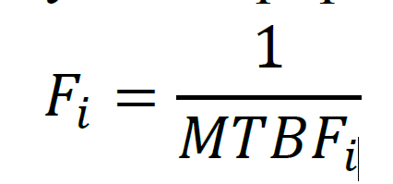
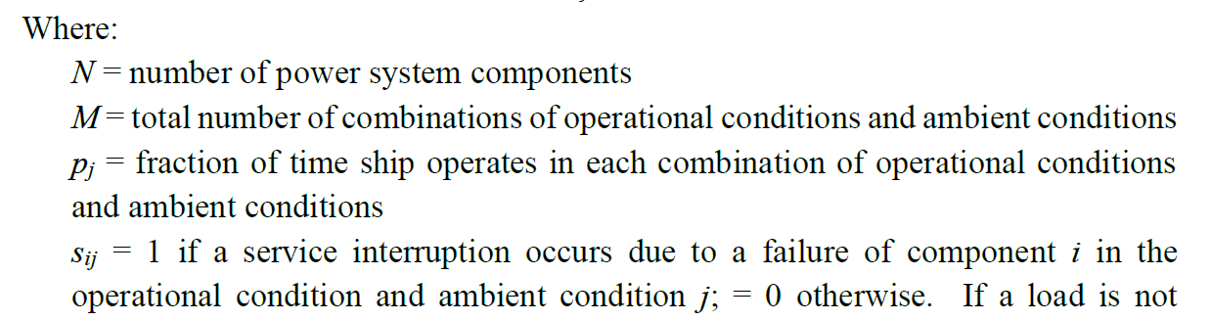
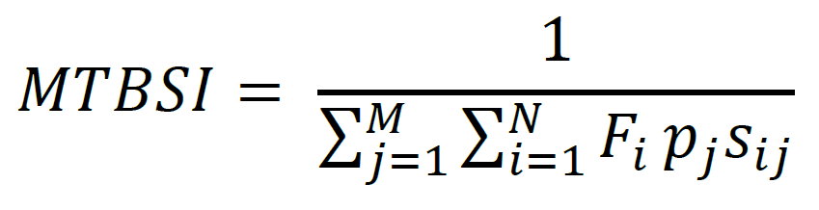
Estimate load MTBSI (Continued)
The failure rate (F_{i}) for each power system equipment / component i, is given by:
The MTBSI for each load is given by
A steady-state simulation or quasi-steady state simulate may be employed to determine s_{ij}
Calculations assume probability of simultaneous failure of power system components is small
If loads can fail such that they impact power quality of other loads, and if the rate of such failure can impact MTBSI calculations, then these loads should be considered within the set of power system components.

Slide 13
QOS Mitigation
Load shedding
Energy Storage
Redundant source with automatic bus transfer
Reliable power system equipment
Generator set ratings
Power conversion equipment modularity (N+1 modules)
Grounding system selection

